Slide 1
Lecture 5

Slide 2
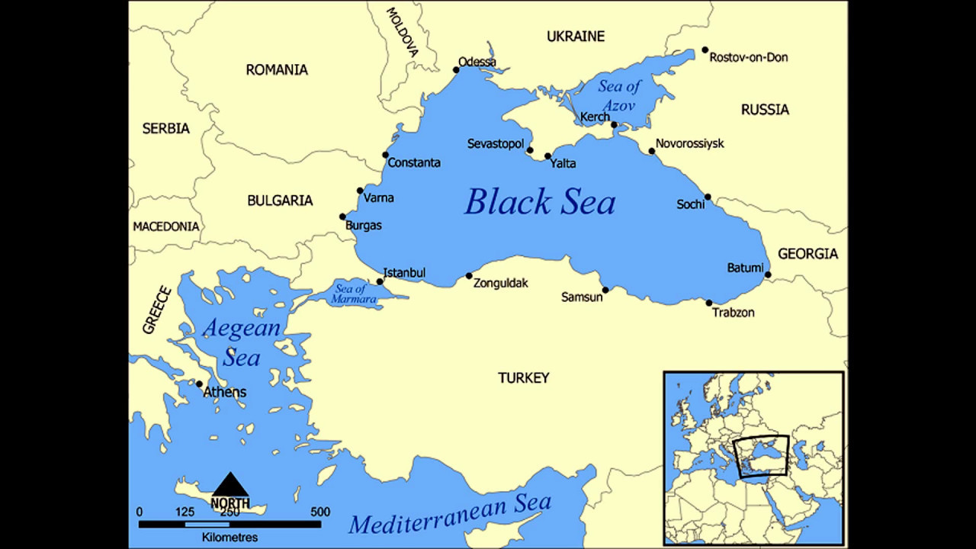
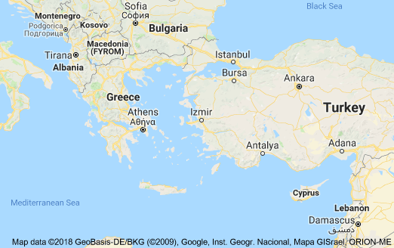
Location
Greek civilization occurred in the area around the Greek mainland, on a peninsula that extends into the Mediterranean Sea.
It started in cities on the Greek mainland and on islands in the Aegean Sea.
Towards the later or Hellenistic period, Greek civilization spread to other far away places including Asia Minor and Northern Africa.

Slide 3
Geography of Greece
Most of the Greek mainland was rocky and barren and therefore bad for agriculture.
Most Greeks therefore lived along the coastline or on islands where the soil was good for farming.
The Aegean and Mediterranean Seas provided a means of communication and trade with other places.

Slide 4
Historical Background Period
The period of ancient Greek history can be divided into four as follows:
1100 B. C. – 750 B. C. Greek Dark Ages (Collapse of the Mycenaean civilization)
750 B. C. – 490 B. C. Archaic Period
5000 B. C. – 323 B. C. Classical Period
323 B. C. – 147 B. C. Hellenistic Period
The classical and archaic period are sometimes collectively referred to as Hellenic period.

Slide 5
Greek City Planning and Design Planning and Design Principles
The ancient Greek civilization had established principles for planning and designing cities.
City form were of two types:
Old cities such as Athens had irregular street plans reflecting their gradual organic development.
New cities, especially colonial cities established during the Hellenistic period, had a grid-iron street plan
Certain things were common among cities:
The overall division of spaces in 3 parts: acropolis, agora and the town.

Slide 6
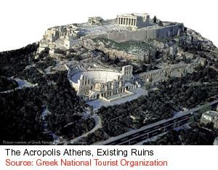
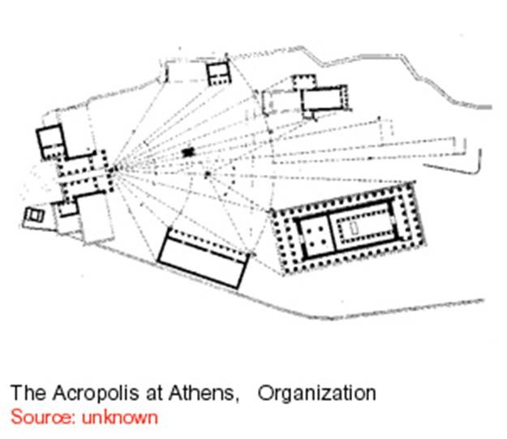
Greek City Planning and Design Planning and Design Principles
THE ACROPOLIS
The acropolis in Athens was a religious precinct located on one of the hills of the city.
The artist and architects to build a new city of temples to glorify the gods.
The acropolis combined Doric orders and ionic orders in a perfect composition in four buildings; the Propylea, the Parthenon, the Erechtheumn, and the temple of Nike.

Slide 7
Greek City Planning and Design The Agora
The Agora was the most important gathering place in a Greek city.
It started as an open area where the council of the city met to take decisions.
With time buildings were constructed to define and enclose the space
It also transformed into a place for combined social, commercial and political activities.
It emerged as the heart of Greek intellectual life and discourse.
It was usually located on a flat ground for ease of communication.
It was placed to be easily accessible from all directions.
In many cities, it is also located close to the Acropolis.

Slide 8
Greek City Planning and Design The Town
The town was where the people lived.
This was the domain of women, who did not have any public role.
Early Greek towns had an irregular street pattern, resulting from its organic growth.
Later Hellenistic towns such as Prienne had a formal rectilinear pattern.
The town was made up of only residential houses.

Slide 9
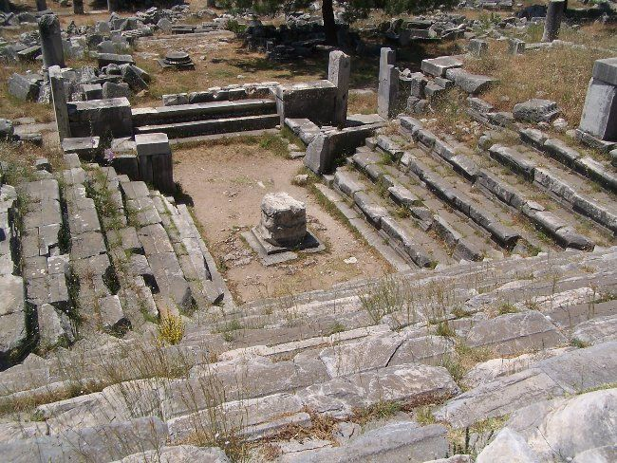
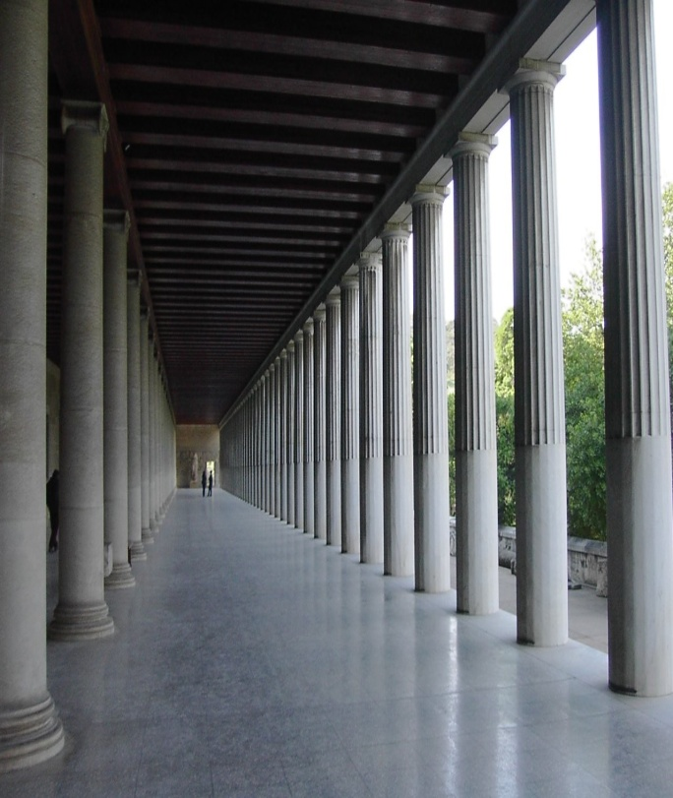
Buildings & Other Arch. Elements Building Types
The major architectural element of the Greek civilization is the order and their principal building type is the temple.
Greek buildings also feature civic buildings such as theater, council chamber, stoa, etc
Greeks invented the classical orders of architecture.
Their invention of the orders was a result of the search for rational methods of expressing beauty.
The orders embody a system of proportion that determines how the whole building looks.

Slide 12
Materials, Construction & Tech. Materials
Examination of Greek architecture points to three common materials of construction
These are Stone, timber and clay
Stone was the most common construction material for buildings
Greece had an abundant supply of stone, particularly marble
• Stone was used for all types of temple and civic construction
The characteristic grey color of the stone of the area is also what gives most ancient Greek buildings their characteristics.

Slide 13
Materials, Construction & Tech. Materials
Timber was used mainly for roofing.
It was a very scarce commodity and it also had limited length.
This limited its use.
The limitation in length meant that the width of buildings was restricted and only very important buildings such as the Parthenon could go beyond a certain width.
Clay was used mostly in housing construction.
Clay was made into sun dried blocks for use in construction.

Slide 14
Materials, Construction & Tech. Construction and Technology
Building blocks were not bonded, but are rather held in position by their weight.
Then the rough stones were finished to achieve the final form and treatment of the building.
Finishing enables the builders to create buildings of a particular order.
It is in finishing that the Greeks showed their mastery of construction.

Slide 15
Principles of Arch. Organization Ideas about Architectural Aesthetics
The Greeks believed that mathematical proportion is at the root of beauty.
They also believed that the human body has the best of proportions.
Greeks also valued harmony, balance and symmetry in design.
Greeks developed principles based on their believes about aesthetics.
These principles were refined over time as they are applied in building.
With time they developed into a standard that is widely applied.

Slide 17
GREEK BELIEFS

